Slide 1
AWS Elastic Load balancing inside VPC
BY: Shakti Taneja
Cloud System Administration

Slide 2
Contents
Introduction
Components of AWS Involved
Procedure
Working

Slide 3
Introduction
This project involves the creation of at least two linux instances that are created in a virtual private cloud that is not given by default. An elastic load balancer is created to which the instances are attached. A php or html based file is uploaded to the instances by ftp. All the work done is done under a newly created VPC that has suitable number of subnets and an appropriate gateway.

Slide 4
Components of AWS involved
Amazon EC2 - elastic cloud compute provides web based cloud , allows you to obtain and configure capacity with minimal friction. provides you with complete control of computing resources. reduces time required to obtain and boot new server instances to minutes, quickly change capacity
Elastic Block Store (EBS) provides persistent block storage volumes and is automatically replicated within its Availability Zones to protect from component failure . It is designed for application workloads that benefit from fine tuning for performance, cost and capacity . typical use cases: Big Data Analysis and NoSQL databases, data warehousing, stream and log processing applications.

Slide 5
Elastic load Balancing
offers three types of load balancers:
1. classic load balancer for http, htpps and tcp | have an existing application running in ec2
2. application load balance for http and https| when a flexible feature set is required | provide advanced routing
3. network load balancer for tcp and tls | need ultra high performance | handle millions of request/sec automatically distributes incoming application traffic across multiple ec2 instances, enables to achieve fault tolerance in application, seamlessly provides required amount of load balancing capacity needed to route application traffic.

Slide 6
Amazon VPC lets you provision logically isolated section of AWS where you can launch AWS in a virtual network
that you define
complete control over virtual networking environment includes section of ip address range, creation of subnets,
configuration of route tables and network gateways
features:
multiple connectivity options, connect directly to internet
connect to internet using network address translation
connect securely to corporate datacenter
connect privately to other vpc
connect to amazon s3 without using internet gateway or NAT
secure
simple
scalability and reliability of aws

Slide 7
Procedure
Create desired VPC, its subnets (2 or 4) and a gateway
Create 2 or more linux instances for each subnet in the created VPC
Install httpd, vsftpd and php in those instances, open ports for http, ftp in the instances and transfer index.php and Auth.php from system to instances and move them to /var/www/html
Create a classic/application load balancer and register those instances created to this load balancer

Slide 8
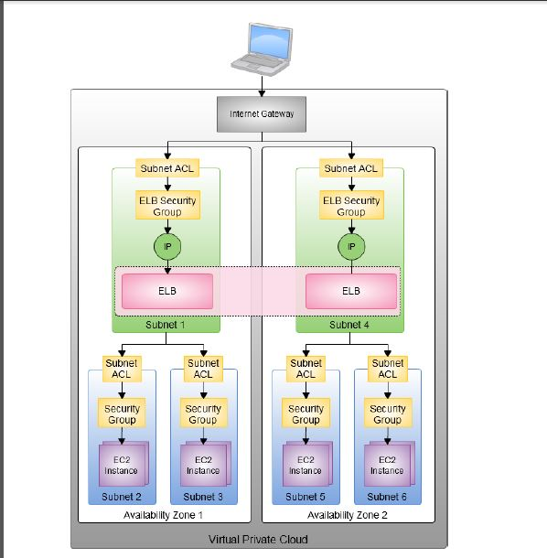
Working

Slide 9
Thank You

